Slide 1
Liberty University Engineering Enhancement Proposal

Slide 2
Proposal 1:
Introduction to Engineered Propulsion
Proposal 2:
New Course: “History of Engineering”
Proposal 3:
Creation of a CSER App

Slide 3
Liberty University Engineering Department Proposal 1
Featuring: Introduction to Engineered Propulsion

Slide 4
Preface
For aerospace, automotive, and energy
To uphold the credibility of LU and requests of students
Alignment with Liberty University’s mission
Notes:
Talk about changes in modern engineering
64% expressed interest in this course

Slide 5
Currently
Existing curriculum gaps
Competitor institutions have similar courses
Lacking in mission
“Training Champions for Christ”

Slide 6

Plan Description

Slide 7
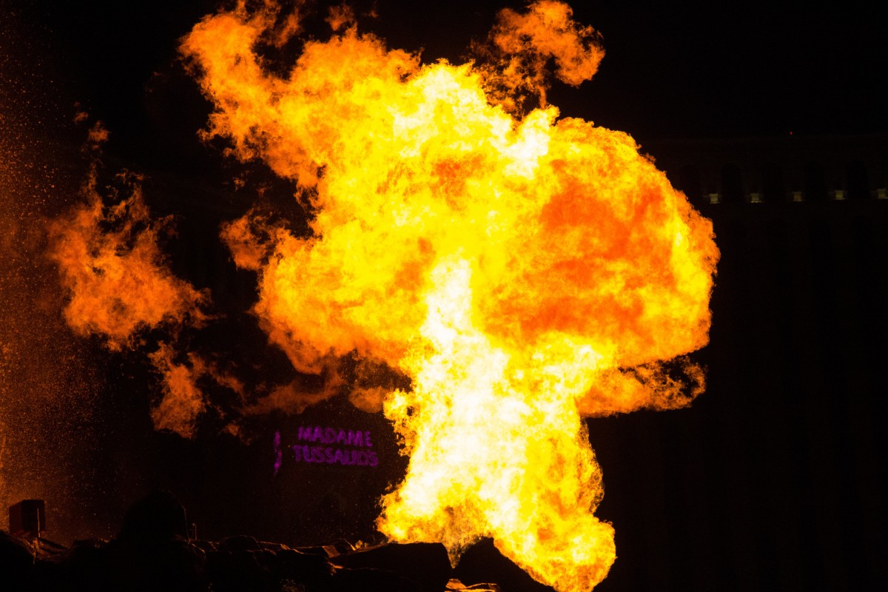
Solution
Creation of a 3-credit technical elective course
Structured on the fundamentals of propulsion
Lecture, experiments, project-based learning

Slide 8
Notes:
64% expressed interest in the course
Highly desired

Slide 9
Benefits
Enhancement of University reputation
Interdisciplinary learning opportunities
A step towards an Aerospace Engineering Cirriculum

Slide 10
Feasibility
Faculty expertise
Laboratory readiness
Strong student demand
Notes:
Low risk option

Slide 11
Budget
Item | Cost | Specification
Faculty Salary | $15000 | For adjunct faculty or additional workload for current faculty.
Software Licenses | $5000 | MATLAB and ANSYS.
Curriculum Development | $5000 | Initial capital.
Laboratory Expenditures | $3000 | Includes raw material for machining and other expenditures for labs. Note: For a section of 30 students.

Slide 12
Timeline
Phase 1
Proposal review and approval
Phase 2
Course design and preparation
Phase 3
Implementation (Spring 2026)
Phase 4
Post implementation review
Notes:
Phase 1: Proposal Development and Review
Early May 2025: Receive input from faculty and department leadership.
Late May 2025: Submit proposal for review by the Department of Engineering.
Early June 2025: Schedule department meetings to discuss feedback and revise proposal.
Late June 2025: Seek approval from the university’s curriculum committee.
Phase 2: Course Design and Preparation
July 2025: Develop detailed course content including lecture notes, lab exercises, and project guidelines.
September 2025: Begin procurement of laboratory equipment and software licenses. Organize faculty workshops to train designated instructors on new course material.
October 2025: Set up laboratory spaces and test propulsion system models. Finalize informational details to promote the course.
November 2025: Open course registration for the Spring 2026 semester. Host informational sessions for students to introduce the course.
Phase 3: Implementation
January 2026: Officially launch the course at the beginning of the spring semester.
February - April 2026: Conduct lectures, labs, and project-based learning activities per the course schedule.
April 2026: Host a departmental showcase where students present their capstone projects to faculty and students.
May 2026: Evaluate student performance, collect feedback, and document best practices for future iterations of the course.
Phase 4: Post-Implementation Assessment and Enhancement
June 2026: Analyze enrollment numbers, student performance, and feedback to assess the course’s success against evaluation criteria.
July 2026: Identify areas for improvement and revise the course accordingly.
August 2026: Prepare for a second offering of the revised course in Fall 2026.

Slide 13

Evaluation Metrics
Student enrollment and performance outcomes
Impact of capstone project
Career placement results

Slide 14
Propelling Liberty University Academics
Takeaways:
Addresses critical curriculum gaps
Prepares students for the modern engineering workforce
Embodies LU’s mission
Solid feasibility and overwhelming student interest

Slide 15
Liberty University Engineering Department Proposal 2
Featuring: Why a history of engineering course should be added

Slide 16
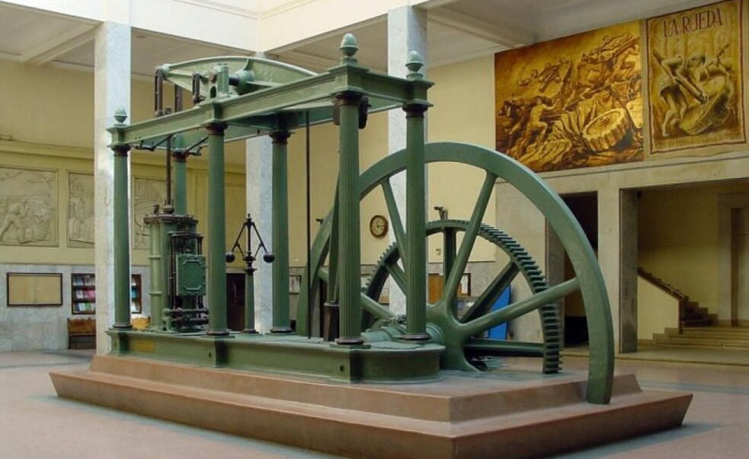

Slide 17
Benefits
Feasibility
How?

Slide 18
Benefits of a history of engineering course
Inspire students
Inform students on environments causing innovation
Highlight past innovator’s historical context
Highlight innovative techniques
Notes:
Highlight innovative techniques that may be used in the future. Many students have heard of these inventors before but this class would add context to what caused them to innovate and lead to those students seeing the opportunities to innovate.

Slide 19
Feasibility
53.8% of students said they would be interested in this course
This course would be a technical elective
Fits in with other class options
Notes:
53.8% of students asked (7/13) said they would be interested in the class. This course would give technical elective credits and would be a 16-week class. This class is not outlandish or out of place

Slide 20
Timeline
Summer 2025
1
Proposal review and approval
Spring 2025
2
Course design and formation
Summer 2026
3
Corse listed

Slide 21
Budget
Item | Cost | Specification
Faculty Salary | $15000 | For adjunct faculty or additional workload for current faculty.
Curriculum Development | $5000 | Initial capital.
Teacher resources | ≈$450 (150 per Professor) | Recourses for the Professor

Slide 22
History is important
Many Engineers would be interested
Unique
Why implement this course
Notes:
History is undeniably important as to tell us what happened in the past and how it can lead us to make decisions in the future. A majority of engineering students would be interested. Also this course in unique and there are no other courses like it.

Slide 23

Conclusion of proposal 2
Notes:
Adding this class would inspire innovation. This course is a realistic and reachable plan. This course is not expensive to the university relative to other class.

Slide 24
Liberty University Serve Department
Featuring: CSER Application

Slide 25

Liberty's Reputation
Liberty is known for its Christian values.
Local reputation questionable
Advancing CSER advances the kingdom

Slide 26
Current Situation
Main economic driver. 8000 Employees.
Controversies, conservative stances, and a minority of misbehaving students lead to questionable reputation.

Slide 27
Current Situation
LU Serve and CSER credits can effectively represent Christ-like student-body.
Current CSER process is lackluster.
CSER App would revamp serving

Slide 28
Plan Objectives
Train Champions for Christ
Improve Liberty's reputation
To steward resources responsibly

Slide 29
Timeline
Summer 2025
LU Serve meeting, group advertisements created, test creation.
Fall 2025
Advertisements posted, testing, meetups begin
Spring 2025
App framework completed, usability testing
Spring 2025 (cont.)
MyLU link changed, advertisements posted.
Notes:
Phase 1: Proposal Development and Review
Early May 2025: Receive input from faculty and department leadership.
Late May 2025: Submit proposal for review by the Department of Engineering.
Early June 2025: Schedule department meetings to discuss feedback and revise proposal.
Late June 2025: Seek approval from the university’s curriculum committee.
Phase 2: Course Design and Preparation
July 2025: Develop detailed course content including lecture notes, lab exercises, and project guidelines.
September 2025: Begin procurement of laboratory equipment and software licenses. Organize faculty workshops to train designated instructors on new course material.
October 2025: Set up laboratory spaces and test propulsion system models. Finalize informational details to promote the course.
November 2025: Open course registration for the Spring 2026 semester. Host informational sessions for students to introduce the course.
Phase 3: Implementation
January 2026: Officially launch the course at the beginning of the spring semester.
February - April 2026: Conduct lectures, labs, and project-based learning activities per the course schedule.
April 2026: Host a departmental showcase where students present their capstone projects to faculty and students.
May 2026: Evaluate student performance, collect feedback, and document best practices for future iterations of the course.
Phase 4: Post-Implementation Assessment and Enhancement
June 2026: Analyze enrollment numbers, student performance, and feedback to assess the course’s success against evaluation criteria.
July 2026: Identify areas for improvement and revise the course accordingly.
August 2026: Prepare for a second offering of the revised course in Fall 2026.

Slide 30



Outcomes
Residents of Lynchburg will receive help
Students are encouraged to serve
Jesus Christ magnified by his people serving

Slide 31

Feasibility
Hurdles
Funding
Skills
Solutions
Liberty's Donors
CS Majors
Word of mouth
Lynchburg Users

Slide 32

Plan Management
Members
Executive Leadership
LU Serve
Role
Approve App
Determine specifications
Application Development
CS Majors

Slide 33
Performance Criteria
1.
Students successfully submit CSER hours
2.
Lynchburg citizens sign up for the app

Slide 34

Conclusion
CSER Application benefits:
Students
Locals
Liberty's Reputation
Jesus Christ's mission

Slide 35
Proposal 1: “Introduction to Engineered Propulsion”
Prepares students for the modern engineering workforce
Solid feasibility and overwhelming student interest
Proposal 2: “History of Engineering”
Proposal 3: Development of a CSER App
Conclusion

Slide 36
Proposal 1: “Introduction to Engineered Propulsion”
Proposal 2: “History of Engineering”
Inspire students
Highlight innovative technqiues
Proposal 3: Development of a CSER App
Conclusion

Slide 37
Proposal 1: “Introduction to Engineered Propulsion”
Proposal 2: “History of Engineering”
Proposal 3: Development of a CSER App
Encourages students to serve
Blesses community
Conclusion

Slide 38
Questions
Thank you

